Slide 1
3341
DISCRETE MATHEMATICS
Module 2:
SET THEORY

Slide 2
Contents
Set theory:-Set representation
Types of Sets
Set operations
Algebra of sets
Inclusion-exclusion principle

Slide 3
What is a set
Definition
A set is a well-defined collection of distinct objects.
The objects in a set are called elements or members of the set.
A set is usually denoted by capital letters in English Alphabet.
Examples
A = {1, 2, 3, 4, 5}
B = {Apple, Mango, Orange}
C = {Python, Java, C++}
Note: Sets are usually represented using capital letters (A, B, C, X, Y, ...).

Slide 4
Common sets
Natural numbers
N = {1,2,3,4,…}
Integers
Z = {….-2,-1,0,1,2,3,….}
Whole numbers
W = {0,1,2,3,4…….}

Slide 5
Characteristics of a set
The collection must be well-defined.
A collection is well-defined if it is possible to decide whether an object belongs to the collection or not.
Well-defined Collections
Set of vowels in English
Set of even numbers less than 10
Set of days in a week
Not Well-defined Collections
Set of beautiful flowers
Set of intelligent students
Set of good movies
:- These are not sets because different people may have different opinions.

Slide 6
Each element is distinct (no repetition).
Repeated elements are listed once
eg : {a,b,a,c,b,a} = {a,b,c}
The order of elements does not matter.
A set is an unordered collection of objects.
eg : {3,2,1} = {1,2,3} = {2,1,3}

Slide 7
Elements of a set
The objects inside a set are called elements or members.
Example
A = {2, 4, 6, 8}
4 ∈ A
5 ∉ A
Symbol | Meaning
∈ | Belongs to (is an element of)
∉ | Does not belong to (is not an element of)

Slide 8
Representation of sets
A set can be represented in two ways:
1. Roster (Tabular) Form
2. Set Builder Form

Slide 9
Roster (Tabular) Form
Definition
In roster form, all the elements of the set are listed inside curly braces.
Examples
A = {1, 2, 3, 4, 5}
B = {a, e, i, o, u}
C = {Monday, Tuesday, Wednesday}

Slide 10
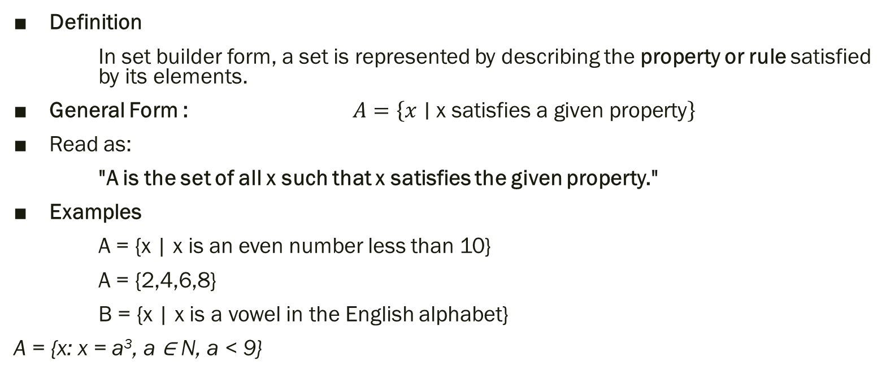
Set builder form
Definition
In set builder form, a set is represented by describing the property or rule satisfied by its elements.
General Form : $A=\left\{x∣\text{x satisfies a given property}\right\}$
Read as:
"A is the set of all x such that x satisfies the given property."
Examples
A = {x | x is an even number less than 10}
A = {2,4,6,8}
B = {x | x is a vowel in the English alphabet}
A = {x: x = a³, a ∈ N, a < 9}

Slide 11
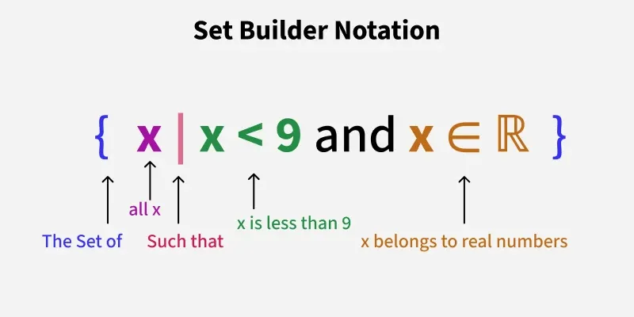
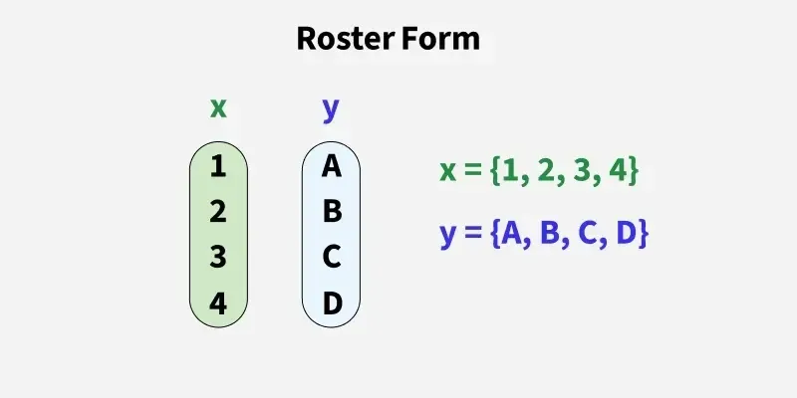

Slide 12
Elements and Cardinality
Let T = {yellow, red, green}
“yellow is an element of T”
“blue is not an element of T”
The cardinality(size) of T is 3.

Slide 13
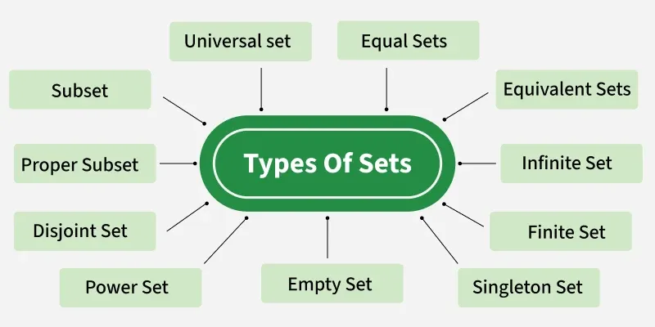
Types of set

Slide 14
Singleton set
A set is referred to as a singleton set when the number of elements in the set is one.
The set of the form S = {a} is called a singleton set
The singleton sets are always finite as it has only 1 element.
Examples :
Set of even prime numbers
Set B = {10}
Set Q = {|x|: x² = 16}

Slide 15
Empty set
The empty set, null set, or void set is a set that does not include any elements.
The symbol (phi) Φ represents the empty set and is written as Φ = { }.
Examples :
  Set A = {x: x is a prime number between 32 and 36}, as there are no prime numbers between 32 and 36 set A is an empty set. Set A = Φ.
  Set B = {x: x are numbers greater than 6 while rolling a die}, there is no number greater than six in a die, so set B is an empty set. Set B = Φ.

Slide 16
Finite set
A finite set is a set that has a countable number of elements.
In other words, you can count how many elements it has, and the counting ends.
The empty set is also finite (with 0 elements).
All singleton sets are finite.
Examples :
  A = {1, 2, 3, 4} → Finite (4 elements)
  B = {"apple", "banana"} → Finite (2 elements)

Slide 17
Infinite set
Infinite Sets are those that have an infinite number of elements present, cases in which the number of elements is hard to determine are known as infinite sets.
Examples :
  A = {1, 2, 3, 4, 5, 6, ...} → Infinite
  B = Set of all stars in the sky → Infinite
  C = Set of all natural numbers → Infinite

Slide 18
Equal set
Two sets having the same elements and an equal number of elements are called equal sets. The elements in the set may be rearranged, or they may be repeated, but they will still be equal sets.
Two sets are equal if every element of one set is also in the other set.
The order of the elements doesn't matter.
Equal sets have the same number of elements (same cardinality).
Examples :
Set A = {1, 2, 6, 5}
Set B = {2, 1, 5, 6}
In the above example, the elements are 1, 2, 5, 6. Therefore, A= B.

Slide 19
Equivalent Set
Equivalent Sets are those which have the same number of elements present in them. It is important to note that the elements may be different in both sets but the number of elements present is equal. For Instance, if a set has 6 elements in it, and the other set also has 6 elements present, they are equivalent sets.
Equivalent sets have the same number of elements.
The elements can be different; it only the count matters.
If two sets A and B are equivalent, we write: A ≈ B
All equal sets are equivalent, but not all equivalent sets are equal.
Examples :
Set A= {2, 3, 5, 7, 11}
Set B = {p, q, r, s, t}
Set A and Set B both have 5 elements hence, both are equivalent sets.

Slide 20
Subset
Set A will be called the Subset of Set B if all the elements present in Set A already belong to Set B. The symbol used for the subset is ⊆.
If A is a Subset of B, it will be written as A ⊆ B
A ⊆ A (Every set is a subset of itself)
∅ ⊆ A (Empty set is a subset of every set)
If A ⊆ B and B ⊆ C, then A ⊆ C (transitive property)
A set with n elements has 2ⁿ subsets (including ∅ the set itself)
Example :
Set A= {33, 66, 99}
Set B = {22, 11, 33, 99, 66}
Then, Set A ⊆ Set B

Slide 21
Proper Subset
A proper set is a subset that contains some but not all elements of the original set. It is not equal to the original set. If A and B are sets, and A is a proper subset of B, we write: A ⊂ B
A proper subset has fewer elements than the original set.
Every proper subset is a subset, but not every subset is proper.
The empty set (∅) is a proper subset of any non-empty set.
The original set is not a proper subset of itself.
Example :
Let B = {1, 2, 3}
Proper subsets of B are:
∅, {1}, {2}, {3}, {1, 2}, {1, 3}, {2, 3}
{1, 2, 3} is a subset of B, but not a proper subset, because it is equal to B.

Slide 22
Power Set
The Powerset of any set A is defined as the set containing all the subsets of set A. It is denoted by the symbol P(A) and read as the Power Set of A.
For any set A containing n elements, the total number of subsets formed is 2^{n}. Thus, the power set of A, P(A) has 2^{n} elements.
It includes:
The empty set (∅)
All individual elements as sets
All combinations of elements
The set itself
Examples :
For any set A = {a,b,c}
Power Set P(A) is,
P(A) = {ϕ, {a}, {b}, {c}, {a, b}, {b, c}, {c, a}, {a, b, c}}

Slide 23
Properties of Power Sets
1. If a set has n elements, its power set has 2ⁿ subsets.
Example: A = {a, b, c} → 3 elements → power set has 2³ = 8 subsets
2. The power set always includes:
- The empty set (∅)
- The original set
3. Power set of ∅ is: P(∅) = {∅}
4. The power set is always larger than the original set (except when the set is empty).

Slide 24
Universal Set
A universal set is a set that contains all the elements of the rest of the sets. It can be said that all the sets are the subsets of Universal sets. The universal set is denoted as U.
Contains all the elements being discussed.
Every set is a subset of the universal set.
Example :
For Set A = {a, b, c, d} and Set B = {1,2},
Universal Set U is,
U = {a, b, c, d,1, 2}

Slide 25
Disjoint Sets
That have two sets A and B that do have no common elements are called Disjoint Sets. The intersection of the Disjoint sets is ϕ, now for set A and set B, A∩B = ϕ.
Disjoint sets can be finite or infinite.
Two sets can be disjointed even if one or both are empty.
Example :
Set A ={a, b, c, d}
Set B= {1,2}
Here, A∩B = ϕ
Thus, Set A and Set B are disjoint sets.

Slide 26
Set Operations
Set Operations can be defined as the operations performed on two or more sets to obtain a single set containing a combination of elements from all the sets being operated upon.
There are three major operations on sets: Union (∪), Intersection (∩), and
Difference (-).
Other operations include Complement, Symmetric Difference, Addition, and Subtraction.

Slide 27
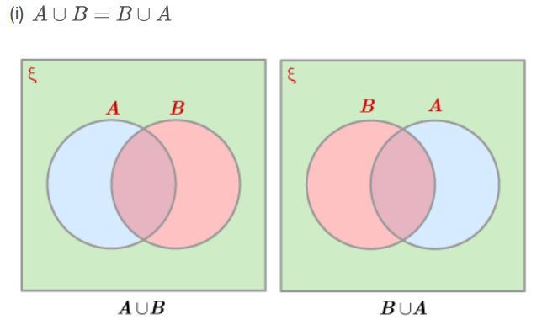
Union of Sets
The Union of Sets A and B, denoted by A ∪ B, is the set of distinct elements that belong to set A or set B, or both.
In simple terms, the union includes every element that appears in either of the two sets(or both), without any repetition.
The union of A = {2, 3, 4} and B = {3, 4, 5}.
A ∪ B = {2, 3, 4, 5}.

Slide 28
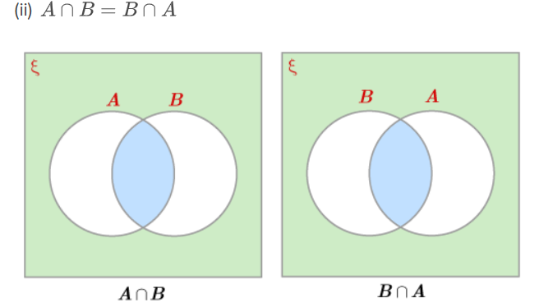
Intersection
The intersection of sets A and B, denoted by A ∩ B, is the set of elements that belong to both A and B, i.e. set of the common elements in A and B.
In other words, the intersection contains only those elements that are present in both sets.
The intersection of A = {2, 3, 4} and B = {3, 4, 5}
A ∩ B = {3, 4}.

Slide 29
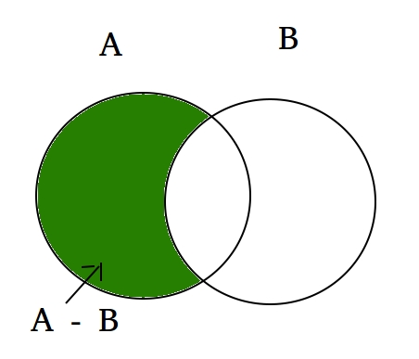
Set Difference
The difference between sets is denoted by 'A - B', which is the set containing elements that are in A but not in B i.e., all elements of A except the element of B.
If A = {1, 2, 3, 4, 5} and B = {2, 4, 6, 8}
A - B = {1, 3, 5}

Slide 30
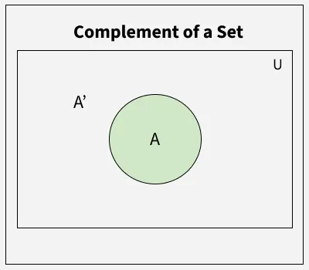
Complement of a set
If U is a universal set and A is any subset of U, then the complement of A consists of all the elements in U that are not in A.
Let U = {1, 2, 3, 4, 5, 6, 7, 8} And A = {1, 2, 5, 6}
Then, the complement of A, denoted as A′, will be: A′ = {3, 4, 7, 8}

